Slide 1
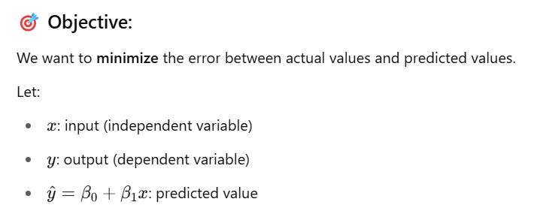
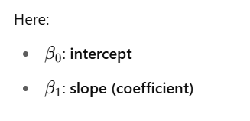
✅ Part 1: Simple Linear Regression

Slide 2
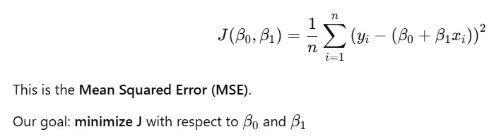
✅ Step 1: Define the Cost Function (Mean Squared Error)
We define the cost function as:

Slide 3
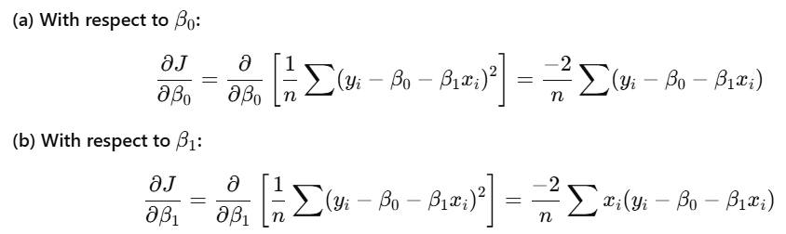
✅ Step 2: Take Partial Derivatives

Slide 4
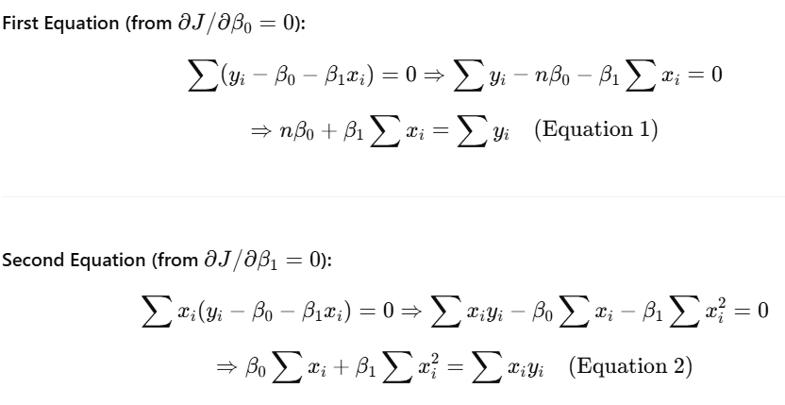
✅ Step 3: Set Derivatives = 0 (Minimize the Loss)

Slide 5
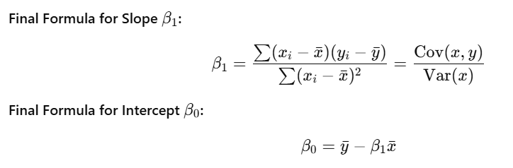
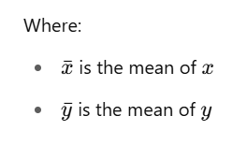
✅ Step 4: Solve System of Equations

Slide 6
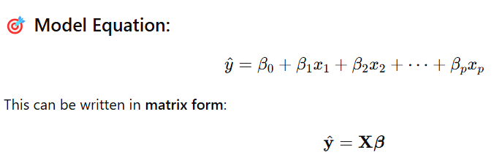
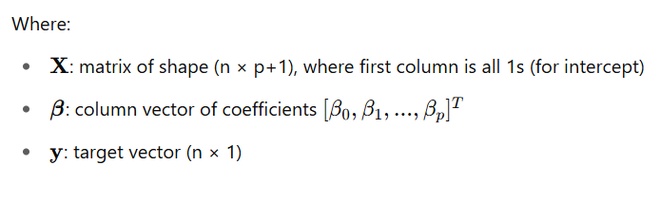
✅ PART 2: Multiple Linear Regression

Slide 7


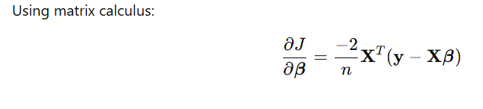
✅ Step 1: Define the Cost Function

Slide 8
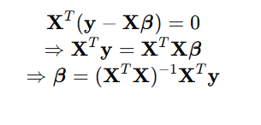
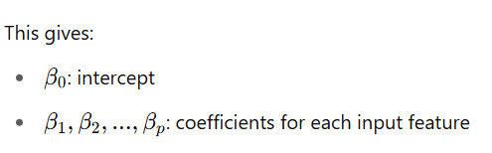
Step 3: Set Derivative = 0 and Solve
✅ Final Matrix Formula for Coefficients

Slide 9
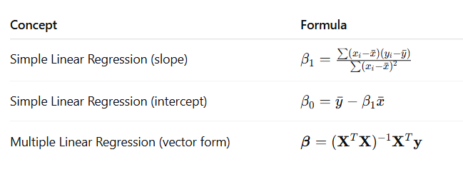
✅ Key Notes

Slide 10
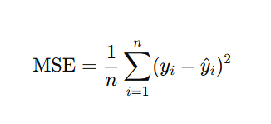
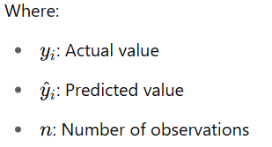

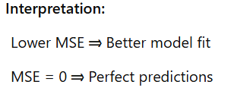
PART 3: Mean Squared Error (MSE)
Definition
Mean Squared Error is a measure of how well the model predictions approximate the actual outcomes.
It penalizes larger errors more heavily than smaller ones.
Formula :
Matrix Form of MSE: =

Slide 11

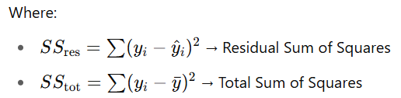
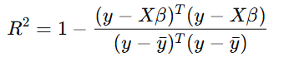
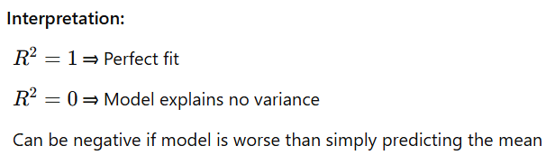
PART 4: Coefficient of Determination (R² Score)
Definition
R² Score tells us how much of the variability in the dependent variable is explained by the model.it is also known as the "Goodness of Fit".
Formula: =
Matrix Form:

Slide 12
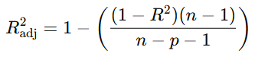
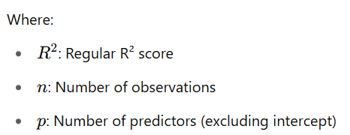
PART 5: Adjusted R² and Other Evaluation Metrics
Why Adjusted R²? Unlike R², which always increases when more predictors are added, Adjusted R² penalizes for adding
Formula: =
Interpretation:
Adjusted R² increases only if the new feature improves the model.
More reliable when comparing models with different numbers of features.

